Slide 1
Four bells being to toll together and toll respectively , at intervals of 6 s, 9 s, 10 s and 12 s. how many times will they toll together in 1 hr excluding the one at the start?
a)48 times b)20 times c)30 times d)180 times
2. Monika purchased a pressure cooker at 9/10th its selling price and sold it at 8% more than its SP. Find her gain percent.
a)10% b) 20% c) 30% d) 40%

Slide 2
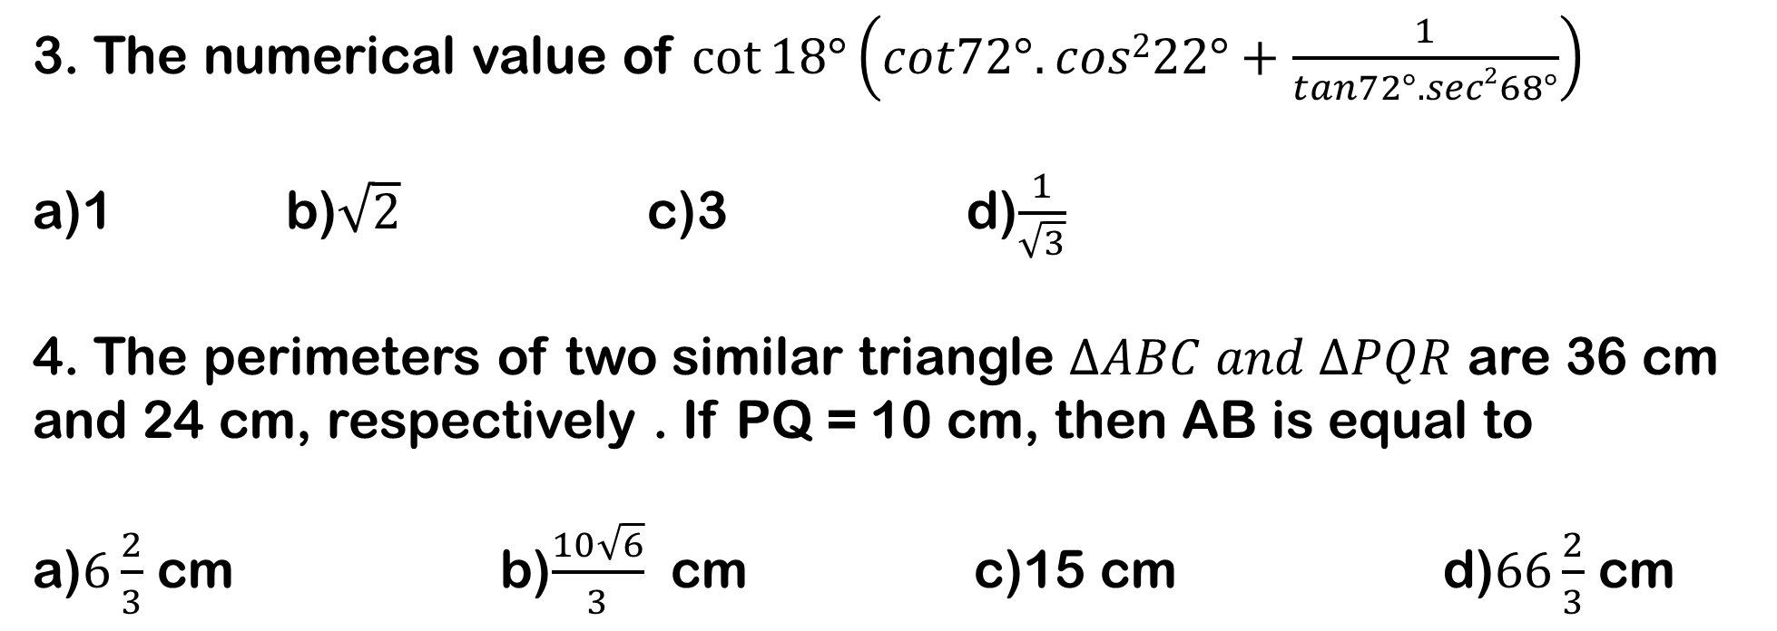
3. The numerical value of $\cot{18°\left(cot72°.cos222°+\frac{1}{tan72°.sec268°}\right)}$
a)1 b)$\sqrt{2}$ c)3 d)$\frac{1}{\sqrt{3}}$
4. The perimeters of two similar triangle $∆ABC and ∆PQR$ are 36 cm and 24 cm, respectively . If PQ = 10 cm, then AB is equal to
a)$6\frac{2}{3}$ cm b)$\frac{10\sqrt{6}}{3}$ cm c)15 cm d)$66\frac{2}{3}$ cm

Slide 3
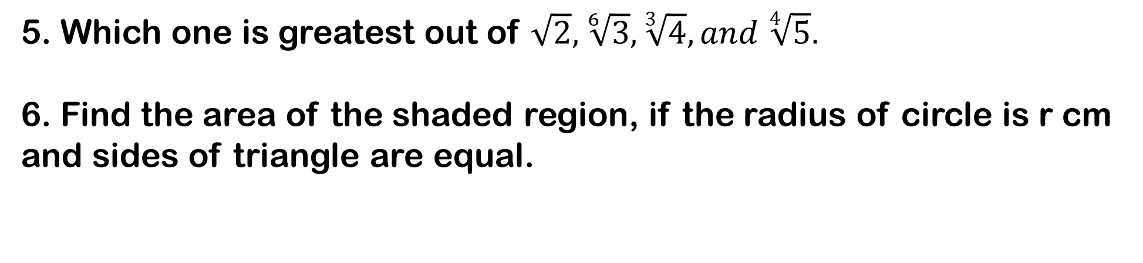
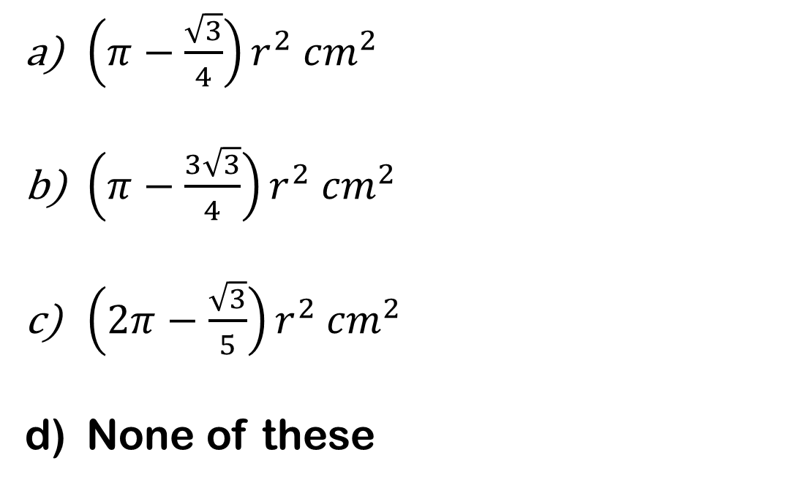
5. Which one is greatest out of $\sqrt{2}, \sqrt[6]{3}, \sqrt[3]{4}, and \sqrt[4]{5}.$
6. Find the area of the shaded region, if the radius of circle is r cm and sides of triangle are equal.
$\left(π−\frac{\sqrt{3}}{4}\right)r^{2} {cm}^{2}$
$\left(π−\frac{3\sqrt{3}}{4}\right)r^{2} {cm}^{2}$
$\left(2π−\frac{\sqrt{3}}{5}\right)r^{2} {cm}^{2}$
None of these

Slide 4
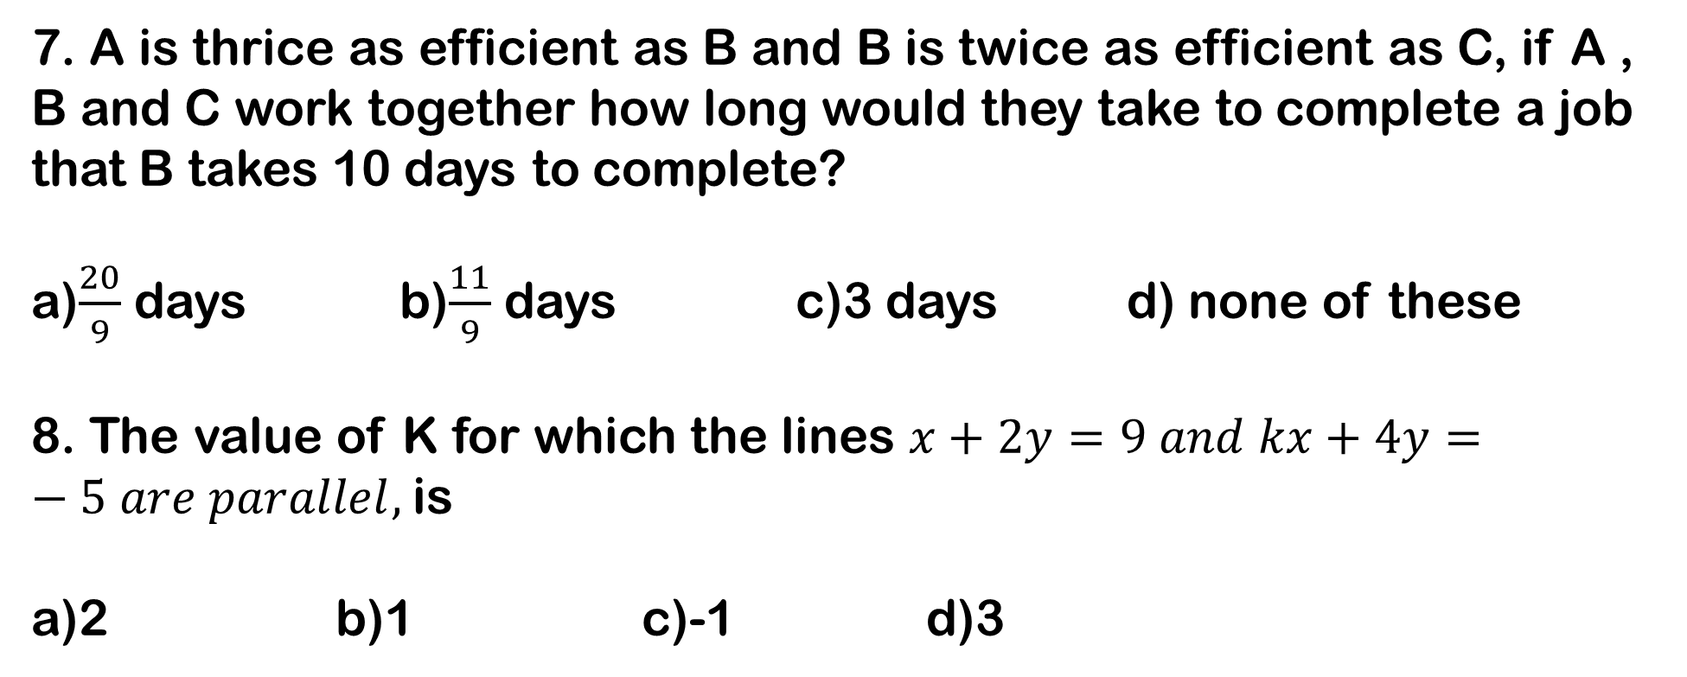
7. A is thrice as efficient as B and B is twice as efficient as C, if A , B and C work together how long would they take to complete a job that B takes 10 days to complete?
a)$\frac{20}{9}$ days b)$\frac{11}{9}$ days c)3 days d) none of these
8. The value of K for which the lines $x+2y=9 and kx+4y=−5 are parallel,$is
a)2 b)1 c)-1 d)3

Slide 5
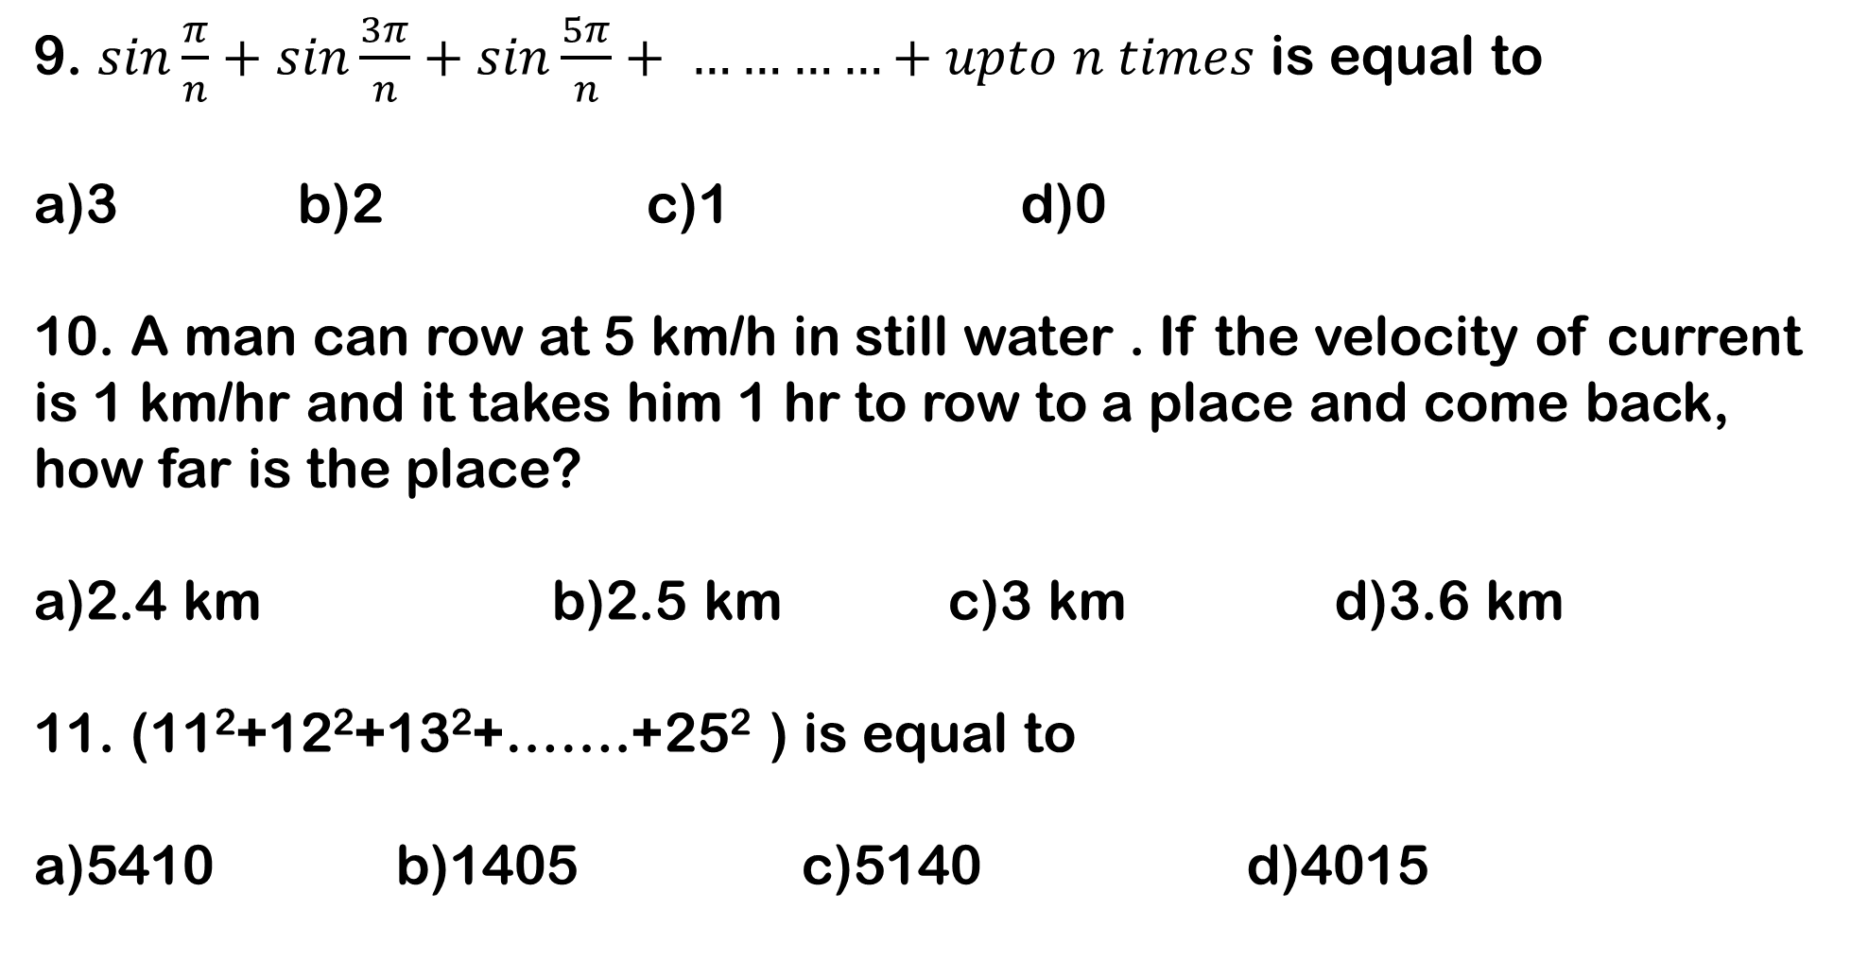
9. $sin\frac{π}{n}+sin\frac{3π}{n}+sin\frac{5π}{n}+ …………+upto n times$ is equal to
a)3 b)2 c)1 d)0
10. A man can row at 5 km/h in still water . If the velocity of current is 1 km/hr and it takes him 1 hr to row to a place and come back, how far is the place?
a)2.4 km b)2.5 km c)3 km d)3.6 km
11. (11²+12²+13²+…….+25² ) is equal to
a)5410 b)1405 c)5140 d)4015

Slide 6
12. If 6 men and 8 boys can do a piece of work in 10 days while 26 men and 48 boys can do the same in 2 days , what is the time taken by 15 men and 20 boys in doing the same type of work?
a)4 b)5 c)6 d)7
13. An item of marked price Rs. 240 for sale. If two successive discounts of 10% and 5% are allowed on the sale price, the selling price of an article will be
a)Rs. 205.20 b)Rs. 204 c)Rs. 34.80 d)Rs. 36

Slide 7
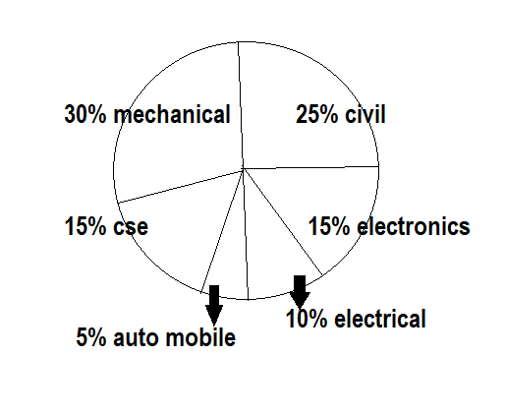
14.
Seats in Various Engineer Branch of Delhi Engineering College.
Total Seats = 400

Slide 8
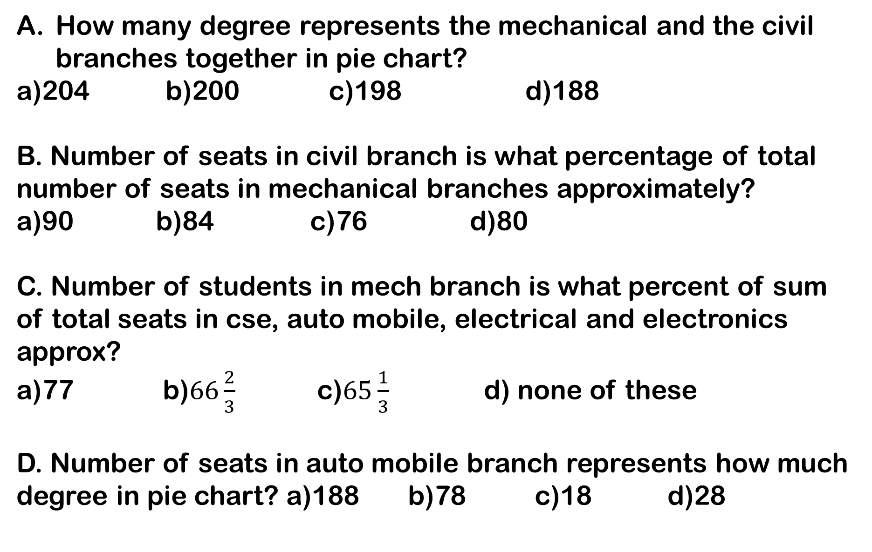
How many degree represents the mechanical and the civil branches together in pie chart?
a)204 b)200 c)198 d)188
B. Number of seats in civil branch is what percentage of total number of seats in mechanical branches approximately?
a)90 b)84 c)76 d)80
C. Number of students in mech branch is what percent of sum of total seats in cse, auto mobile, electrical and electronics approx?
a)77 b)$66\frac{2}{3}$ c)$65\frac{1}{3}$ d) none of these
D. Number of seats in auto mobile branch represents how much degree in pie chart? a)188 b)78 c)18 d)28

Slide 9
15. On what sum does the difference between the compound interest and the simple interest for 3 year at 10% is Rs 31 ?
a)Rs 1500 b)Rs 1200 c)Rs 1100 d)Rs 1000

